Slide 1

VibeBot: The Empathetic AI Companion
Team Name | CIEL Kingston vibeAIthon 2025

Slide 2
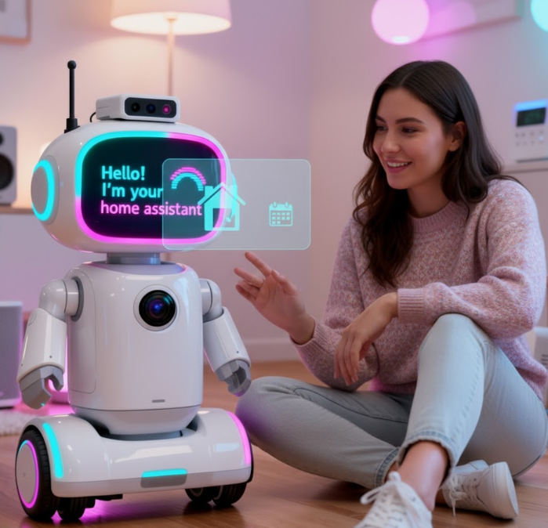
“Our AI Healthcare Bot supports those who need continuous care and companionship — especially the elderly and mobility-impaired — by providing safety, assistance, and emotional support, both at home and in healthcare facilities.”

Slide 3
Problem Recap & Objective
Problem: Elderly and mobility-challenged individuals lack affordable, reliable, and private assistive companions. Existing robots are costly, complex, and depend on cameras or constant internet.
User Pain Points:
High cost & complexity
Privacy issues with cameras
No emotional connection
Internet dependency
Objective: Build an AI-powered healthcare bot that follows users via Wi-Fi signals, monitors vitals, and provides voice-based companionship — all at low cost.

Slide 4
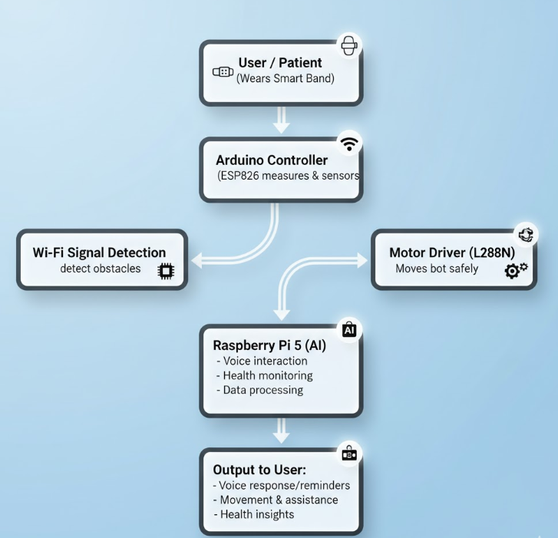
Flow Chart

Slide 5
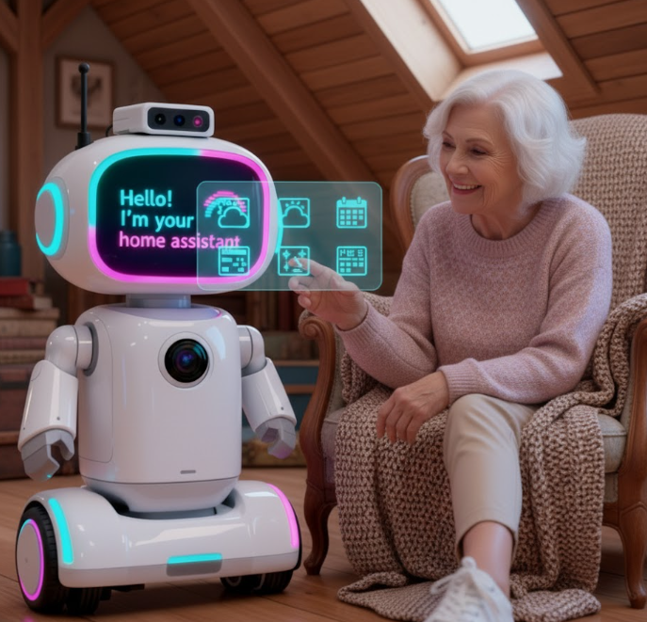
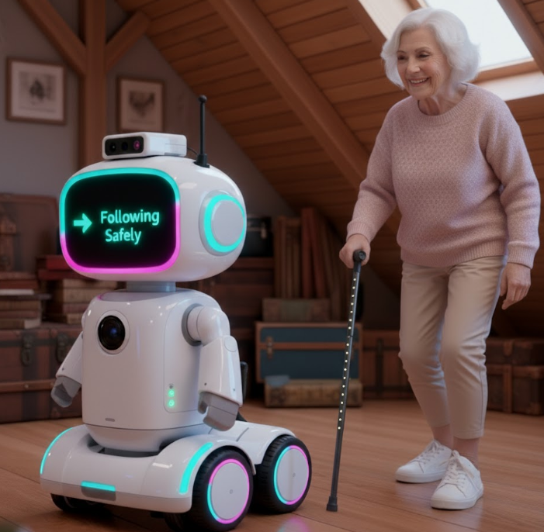
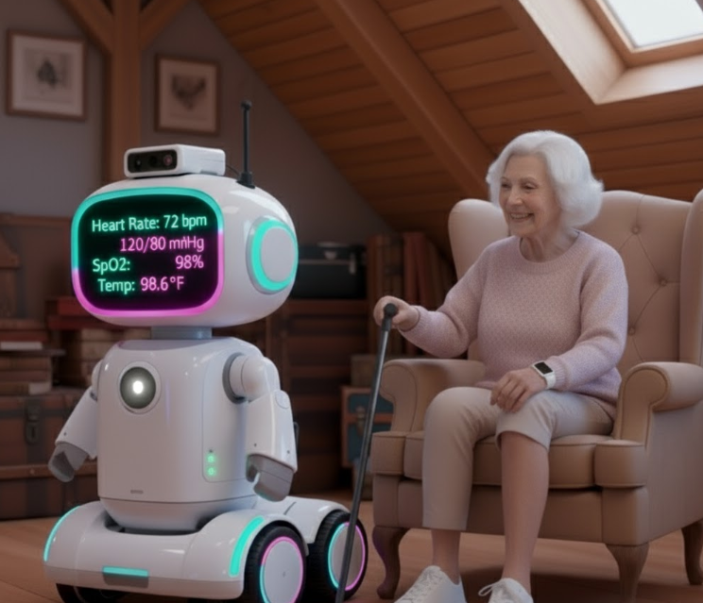
People with Mobility Challenges or Disabilities
Helps users move safely around their home without needing constant human assistance.
The bot can follow them, avoid obstacles, and alert caregivers if health readings are abnormal.
Elderly People Living Alone
Many seniors face mobility issues and loneliness.
The bot acts as a companion and safety assistant, reminding them of medications, tracking health vitals, and providing comfort through conversation.
Patients Recovering from Surgery or Illness
Supports short-term recovery by monitoring vital signs and ensuring users stay within safe zones at home.

Slide 6
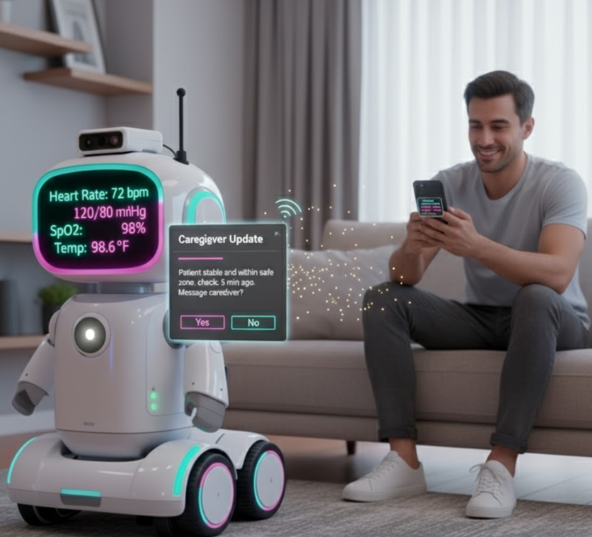
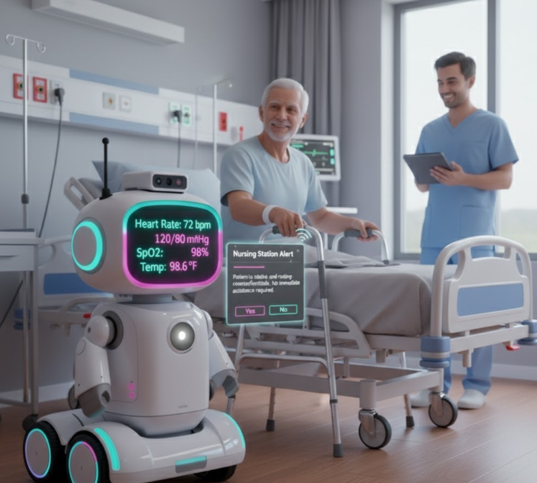
Caregivers and Family Members
Offers peace of mind by tracking the patient’s wellbeing and sending updates.
Reduces caregiver fatigue by handling simple monitoring and communication tasks.
Hospitals, Rehabilitation Centers, and Elder Care Homes
Can be deployed in healthcare facilities to assist patients with limited mobility.
Provides continuous monitoring without replacing human staff.

Slide 7
User Experience & Impact
🧍‍♀️ User Journey:
User wears a smart band or carries phone → bot detects Wi-Fi signal.
Bot follows the user safely using signal strength (RSSI).
Ultrasonic sensors prevent collisions and ensure smooth movement.
Raspberry Pi AI interacts via voice — giving reminders, checking vitals, or chatting.
Continuous care — works online and offline for reliability.
✨ Key Features:
Camera-free Wi-Fi tracking for privacy.
AI voice interaction for companionship and reminders.
Health monitoring via wearable integration.
Obstacle avoidance for safe indoor navigation.
Low-cost and portable assistive design (< ₹15,000).
🚀 Next Steps:
Improve tracking accuracy and battery efficiency.
Integrate emergency alert system and mobile app.
Conduct user testing in elder-care and hospital settings.
Develop market-ready prototype for real-world deployment.
💡 Unique & Innovative:
Privacy-first design — no cameras used for tracking.
Dual-mode operation — works with or without internet.
Combines AI companionship + physical assistance in one device.

Slide 8
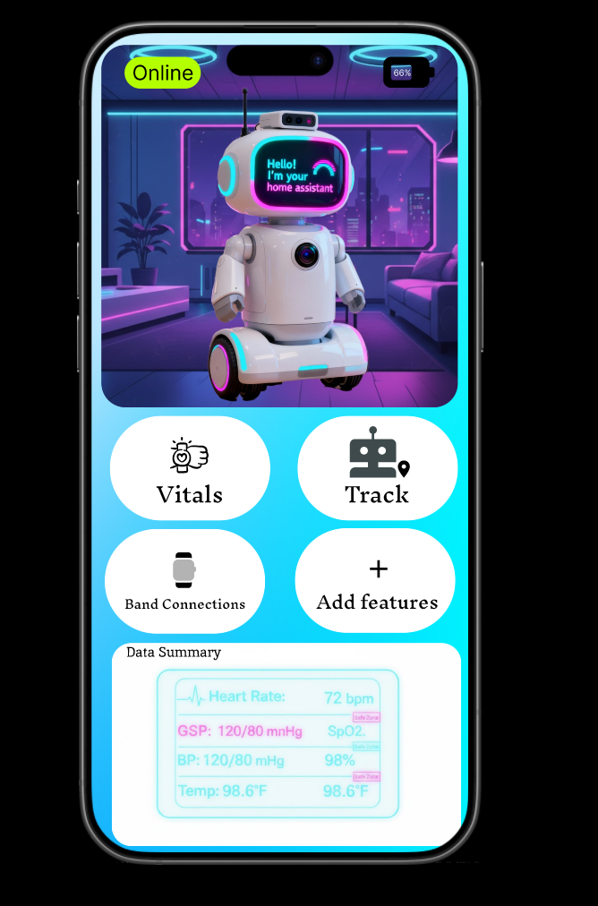
Screenshots

Slide 9
Thank You

